Slide 1
Database Systems
Instructor:
Dr. Hamid Turab Mirza
Department of Computer Science
CUI, Lahore

Slide 2
Definitions
Database: organized collection of logically related data
Data: stored representations of meaningful objects and events
  Structured: numbers, text, dates
  Unstructured: images, video, documents
Information: data processed to increase knowledge in the person using the data
Metadata: data that describes the properties and context of user data

Slide 3
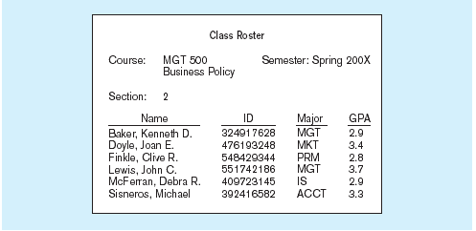
Data in context
Context helps users understand data

Slide 4
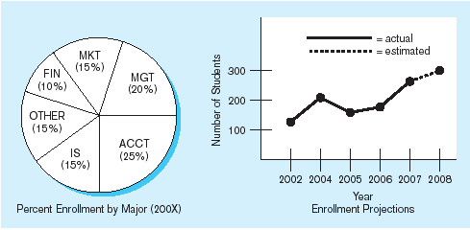
Summarized data
Graphical displays turn data into useful information that managers can use for decision making and interpretation

Slide 5
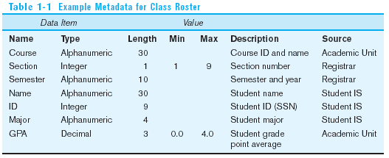
Descriptions of the properties or characteristics of the data, including data types, field sizes, allowable values, and data context

Slide 6
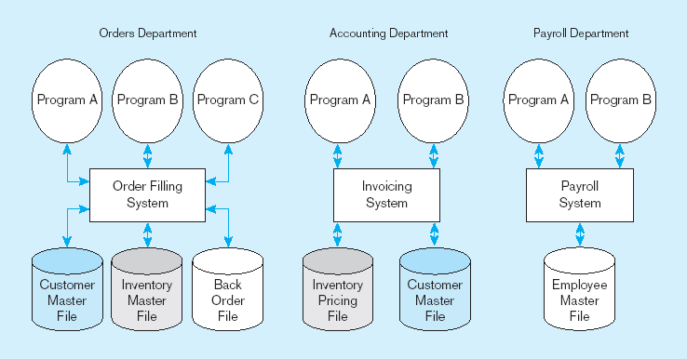
File Processing Systems

Slide 7
Disadvantages of File Processing
Program-Data Dependence
  All programs maintain metadata for each file they use
Duplication of Data
  Different systems/programs have separate copies of the same data
Limited Data Sharing
  No centralized control of data
Lengthy Development Times
  Programmers must design their own file formats
Excessive Program Maintenance
  80% of information systems budget

Slide 8
Problems with Data Dependency
Each application programmer must maintain his/her own data
Each application program needs to include code for the metadata of each file
Each application program must have its own processing routines for reading, inserting, updating, and deleting data
Lack of coordination and central control
Non-standard file formats

Slide 9
Old file processing systems at Pine Valley Furniture Company
Duplicate Data

Slide 10
Problems with Data Redundancy
Waste of space to have duplicate data
Causes more maintenance headaches
The biggest problem:
  Data changes in one file could cause inconsistencies
  Compromises in data integrity

Slide 11
SOLUTION:
The DATABASE Approach
Central repository of shared data
Data is managed by a controlling agent
Stored in a standardized, convenient form

Slide 12
Database Management System
A software system that is used to create, maintain, and provide controlled access to user databases
Order Filing
System
Central database
Contains employee,
order, inventory,
pricing, and
customer data
Invoicing
System
DBMS
Payroll
System
DBMS manages data resources like an operating system manages hardware resources

Slide 13
Advantages of the Database Approach
Program-data independence
Planned data redundancy
Improved data consistency
Improved data sharing
Increased application development productivity
Enforcement of standards
Improved data quality
Improved data accessibility and responsiveness
Reduced program maintenance
Improved decision support

Slide 14
Costs and Risks of the Database Approach
New, specialized personnel
Installation and management cost and complexity
Conversion costs
Need for explicit backup and recovery
Organizational conflict

Slide 15
The Range of Database Applications
Personal databases
Workgroup databases
Departmental/divisional databases
Enterprise database

Slide 16
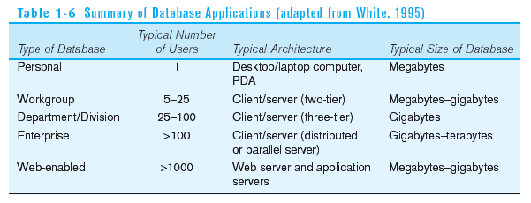

Slide 17
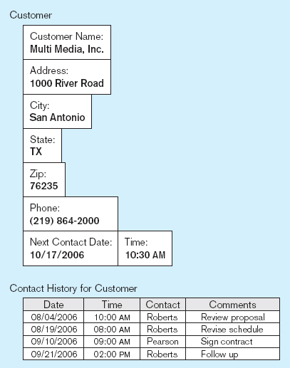
Typical data from a personal database

Slide 18
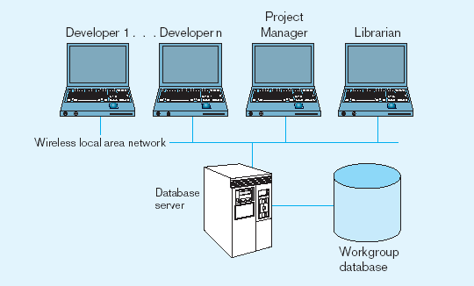
Workgroup database with wireless
local area network

Slide 19
Enterprise Database Applications
Enterprise Resource Planning (ERP)
  Integrate all enterprise functions (manufacturing, finance, sales, marketing, inventory, accounting, human resources)
Data Warehouse
  Integrated decision support system derived from various operational databases

Slide 20
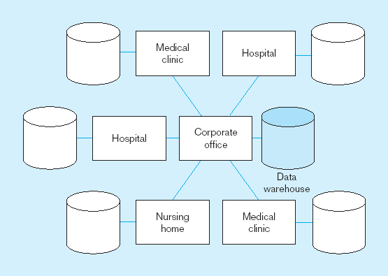
An enterprise data warehouse

Slide 21
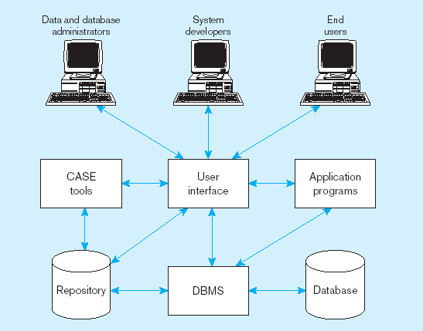
Components of the Database Environment

Slide 22
Components of the
Database Environment
CASE Tools–computer-aided software engineering
Repository–centralized storehouse of metadata
Database Management System (DBMS) –software for managing the database
Database–storehouse of the data
Application Programs–software using the data
User Interface–text and graphical displays to users
Data/Database Administrators–personnel responsible for maintaining the database
System Developers–personnel responsible for designing databases and software
End Users–people who use the applications and databases

Slide 23
Elements of the Database Approach
Data models
  Graphical system capturing nature and relationship of data
  Enterprise Data Model–high-level entities and relationships for the organization
Relational Databases
  Database technology involving tables (relations) representing entities and primary/foreign keys representing relationships
Use of Internet Technology
  Networks and telecommunications, distributed databases, client-server, and 3-tier architectures
Database Applications
  Application programs used to perform database activities (create, read, update, and delete) for database users

Slide 24
Enterprise Data Model
First step in database development
Specifies scope and general content
Overall picture of organizational data at high level of abstraction
Entity-relationship diagram
Descriptions of entity types
Relationships between entities
Business rules

Slide 25
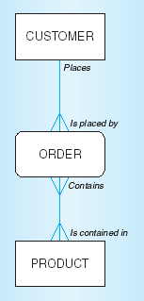
Segment from enterprise data model
Enterprise data model describes the high-level entities in an organization and the relationship between these entities

Slide 26
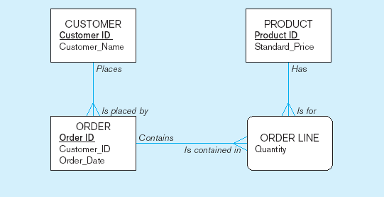
Segment of an Enterprise Data Model

Slide 27
One customer may place many orders, but each order is placed by a single customer
→ One-to-many relationship

Slide 28
One order has many order lines; each order line is associated with a single order
→ One-to-many relationship

Slide 29
One product can be in many order lines, each order line refers to a single product
→ One-to-many relationship

Slide 30
Managing Projects: People Involved
Business analysts
Systems analysts
Database analysts and data modelers
Users
Programmers
Database architects
Data administrators
Project managers
Other technical experts

Slide 31
Business Rules
Statements that define or constrain some aspect of the business
Assert business structure
Control/influence business behavior
Expressed in terms familiar to end users
Automated through DBMS software

Slide 32
A Good Business Rule is:
Declarative–what, not how
Precise–clear, agreed-upon meaning
Atomic–one statement
Consistent–internally and externally
Expressible–structured, natural language
Distinct–non-redundant
Business-oriented–understood by business people

Slide 33
A Good Data Name is:
Related to business, not technical, characteristics
Meaningful and self-documenting
Unique
Readable
Composed of words from an approved list
Repeatable

Slide 34
Data Definitions
Explanation of a term or fact
  Term–word or phrase with specific meaning
  Fact–association between two or more terms
Guidelines for good data definition
  Gathered in conjunction with systems requirements
  Accompanied by diagrams
  Iteratively created and refined
  Achieved by consensus

Slide 35
E-R Model Constructs
Entities:
  Entity instance–person, place, object, event, concept (often corresponds to a row in a table)
  Entity Type–collection of entities (often corresponds to a table)
Relationships:
  Relationship instance–link between entities (corresponds to primary key-foreign key equivalencies in related tables)
  Relationship type–category of relationship…link between entity types
Attribute–property or characteristic of an entity or relationship type (often corresponds to a field in a table)
Notes:
2

Slide 36
Sample E-R Diagram - 1
Pine valley furniture company can purchase items
from a number of different suppliers, who then ship
the items to the manufacturer. The items are
assembled into products that are sold to customers
who order the products. Each customer order may
include one or more lines corresponding to the
Products appearing on that order.
Notes:
2

Slide 37
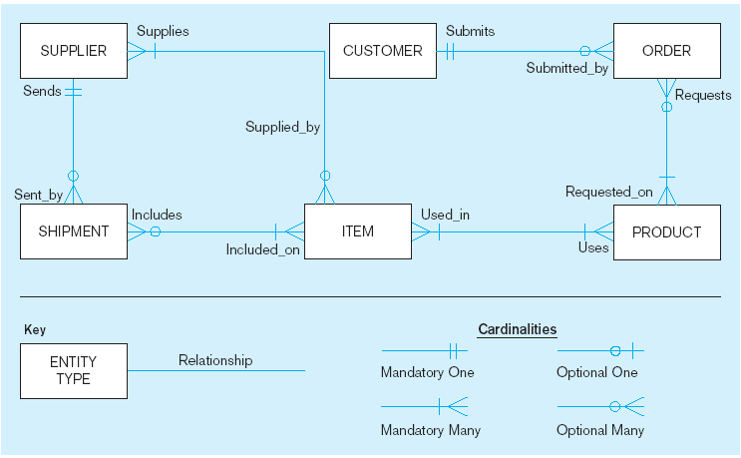
Sample E-R Diagram
A SUPPLIER may supply many ITEMs (by “may supply” we mean the supplier may not supply any items). Each ITEM is supplied by any number of SUPPLIERs (by “is supplied” we mean must be supplied by at least one supplier).
Each ITEM must be used in the assembly of at least one PRODUCT, and may be used in many products. Conversely, each PRODUCT must use one or more ITEMs.
A SUPPLIER may send many SHIPMENTs. On the other hand, each shipment must be sent by exactly one SUPPLIER.
A SHIPMENT must include one (or more) ITEMs. An ITEM may be included on several SHIPMENTs.
A CUSTOMER may submit any number of ORDERs. However, each ORDER must be submitted by exactly one CUSTOMER.
An ORDER must request one (or more) PRODUCTs. A given PRODUCT may not be requested on nay ORDER, or may be requested one one or more orders.
Notes:
3

Slide 38
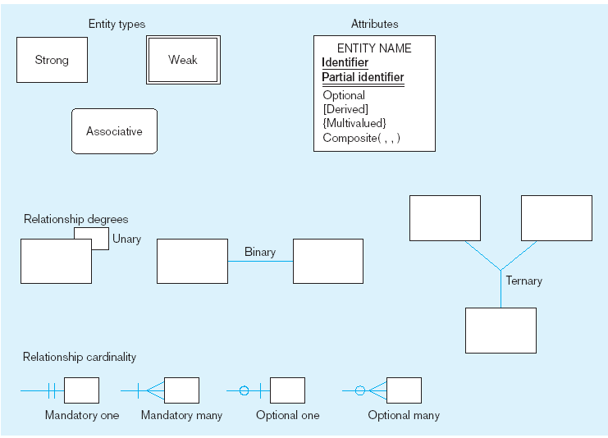
Basic E-R notation
Entity symbols
Attribute symbols
A special entity that is also a relationship
Relationship symbols
Relationship degrees specify number of entity types involved
Relationship cardinalities specify how many of each entity type is allowed
Notes:
8

Slide 39
What Should an Entity Be?
SHOULD BE:
  An object that will have many instances in the database
  An object that will be composed of multiple attributes
  An object that we are trying to model
SHOULD NOT BE:
  A user of the database system
  An output of the database system (e.g., a report)

Slide 40
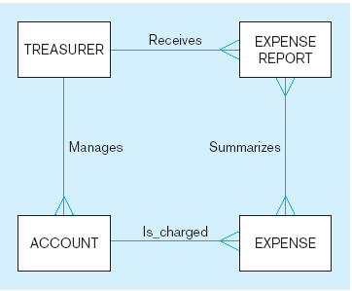
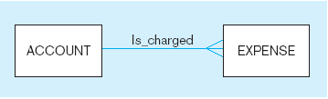
Example of inappropriate entities
System
user
System output
Inappropriate entities
Appropriate entities

Slide 41
Attributes
Attribute–property or characteristic of an entity or relationahip type
Classifications of attributes:
  Required versus Optional Attributes
  Simple versus Composite Attribute
  Single-Valued versus Multivalued Attribute
  Stored versus Derived Attributes
  Identifier Attributes
Notes:
5

Slide 42
Identifiers (Keys)
Identifier (Key)–An attribute (or combination of attributes) that uniquely identifies individual instances of an entity type
Simple versus Composite Identifier
Candidate Identifier–an attribute that could be a key…satisfies the requirements for being an identifier
Notes:
6

Slide 43
Characteristics of Identifiers
Will not change in value
Will not be null
No intelligent identifiers (e.g., containing locations or people that might change)
Notes:
7

Slide 44
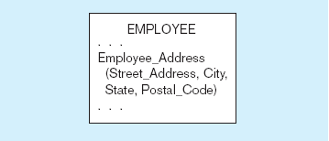
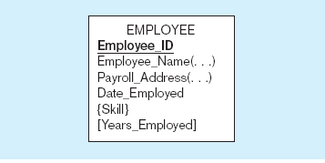
A composite attribute
An attribute broken into component parts
Entity with multivalued attribute (Skill)
and derived attribute (Years_Employed)
Multivalued
an employee can have
more than one skill
Derived
from date employed and current date
Notes:
12

Slide 45
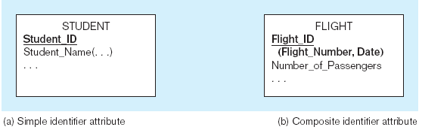
Simple and composite identifier attributes
The identifier is boldfaced and underlined
Notes:
14

Slide 46
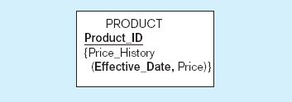
Simple example of time-stamping
This attribute that is both multivalued and composite
Notes:
37

Slide 47
Relationships
  Examples of relationship types:
  A branch is managed by at most one manager
  A manager can manage at most one branch
  A transaction can update one account
  An account can be updated by many transactions
  A customer can own many accounts
  An account may be owned by more than one customer

Slide 48
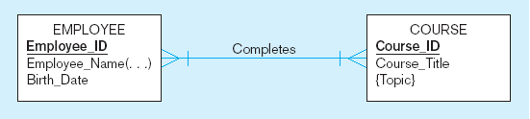
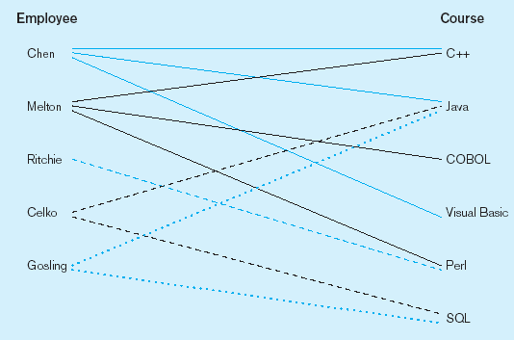
Relationship types and instances
a) Relationship type
b) Relationship instances
Notes:
17

Slide 49
Cardinality of Relationships
One-to-One
  Each entity in the relationship will have exactly one related entity
One-to-Many
  An entity on one side of the relationship can have many related entities, but an entity on the other side will have a maximum of one related entity
Many-to-Many
  Entities on both sides of the relationship can have many related entities on the other side

Slide 50
Cardinality Constraints
Cardinality Constraints - the number of instances of one entity that can or must be associated with each instance of another entity
Minimum Cardinality
  If zero, then optional
  If one or more, then mandatory
Maximum Cardinality
  The maximum number
Notes:
29

Slide 51
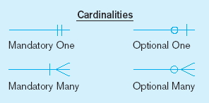
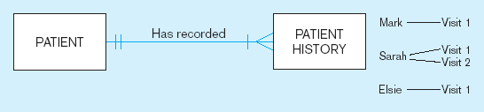
Examples of cardinality constraints
a) Mandatory cardinalities
A patient history is recorded for one and only one patient
A patient must have recorded at least one history, and can have many
Notes:
1

Slide 52
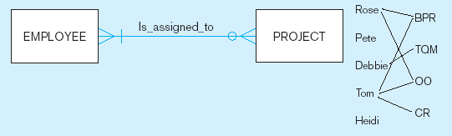
Examples of cardinality constraints (cont.)
b) One optional, one mandatory
A project must be assigned to at least one employee, and may be assigned to many
An employee can be assigned to any number of projects, or may not be assigned to any at all
Notes:
1

Slide 53
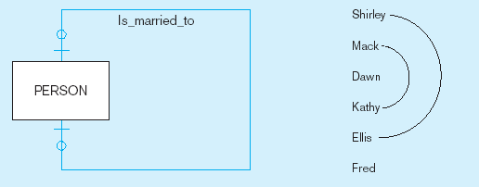
Examples of cardinality constraints (cont.)
a) Optional cardinalities
A person is is married to at most one other person, or may not be married at all
Notes:
1

Slide 54
Sample E-R Diagram – 2
ABC housing society is a medium sized local authority. One of the responsibilities of the
Society is the maintenance and repair of Society owned housing within its boundaries. The
authority wishes to develop an information system to monitor information on housing
repair work, a description of which is as follows:
“For the purpose of housing repair work, the society is divided into a number of areas.
Each area is subdivided into streets or roads, each street or road in likely to have a number
of houses along it. Details of each house are held, along with details of each instance of
repair work carried out to a specific house. Each area is maintained by a single repair team,
although a team may be responsible for more than one area. A repair team consists of a
number of employees, one of whom is designated the team supervisor. The team are
allocated a number of vehicles for use in their work, which are generally used by the
“owning” team only, although are occasionally “borrowed” by other Teams. Each team is
based at a maintenance depot, and in some cases, more than one team may be based at a
single depot”.
Notes:
2

Slide 55
Sample E-R Diagram - 2 (Entities Identified)
ABC housing society is a medium sized local authority. One of the responsibilities of the
Society is the maintenance and repair of Society owned housing within its boundaries. The
authority wishes to develop an information system to monitor information on housing
repair work, a description of which is as follows:
“For the purpose of housing repair work, the society is divided into a number of areas.
Each area is subdivided into streets or roads, each street or road in likely to have a
number of houses along it. Details of each house are held, along with details of each
instance of repair work carried out to a specific house. Each area is maintained by a
single repair team, although a team may be responsible for more than one area. A repair
team consists of a number of employees, one of whom is designated the team supervisor.
The team are allocated a number of vehicles for use in their work, which are generally
used by the “owning” team only, although are occasionally “borrowed” by other Teams.
Each team is based at a maintenance depot, and in some cases, more than one team may be
based at a single depot”.
Notes:
2

Slide 56
Relation
Definition: A relation is a named, two-dimensional table of data
Table consists of rows (records) and columns (attribute or field)
Requirements for a table to qualify as a relation:
  It must have a unique name
  Every attribute value must be atomic (not multivalued, not composite)
  Every row must be unique (can’t have two rows with exactly the same values for all their fields)
  Attributes (columns) in tables must have unique names
  The order of the columns must be irrelevant
  The order of the rows must be irrelevant

Slide 57
Correspondence with E-R Model
Relations (tables) correspond with entity types and with many-to-many relationship types
Rows correspond with entity instances and with many-to-many relationship instances
Columns correspond with attributes
NOTE: The word relation (in relational database) is NOT the same as the word relationship (in E-R model)

Slide 58

Key Fields
Keys are special fields that serve two main purposes:
  Primary keys are unique identifiers of the relation in question. Examples include employee numbers, social security numbers, etc. This is how we can guarantee that all rows are unique
  Foreign keys are identifiers that enable a dependent relation (on the many side of a relationship) to refer to its parent relation (on the one side of the relationship)
Keys can be simple (a single field) or composite (more than one field)
Keys usually are used as indexes to speed up the response to user queries (Discussed Latter)

Slide 59
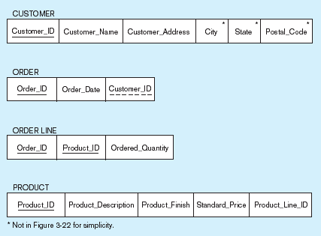
Schema for four relations (Pine Valley Furniture Company)
Primary Key
Foreign Key (implements 1:N relationship between customer and order)
Combined, these are a composite primary key (uniquely identifies the order line)…individually they are foreign keys (implement M:N relationship between order and product)

Slide 60
Integrity Constraints
Domain Constraints
  Allowable values for an attribute. See Table 5-1
Entity Integrity
  No primary key attribute may be null. All primary key fields MUST have data
Action Assertions
  Business rules.

Slide 61
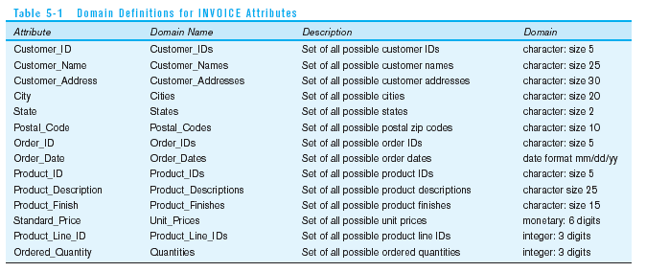
Domain definitions enforce domain integrity constraints

Slide 62
Integrity Constraints
Referential Integrity–rule states that any foreign key value (on the relation of the many side) MUST match a primary key value in the relation of the one side. (Or the foreign key can be null)
  For example: Delete Rules
    Restrict–don’t allow delete of “parent” side if related rows exist in “dependent” side
    Cascade–automatically delete “dependent” side rows that correspond with the “parent” side row to be deleted
    Set-to-Null–set the foreign key in the dependent side to null if deleting from the parent side → not allowed for weak entities

Slide 63
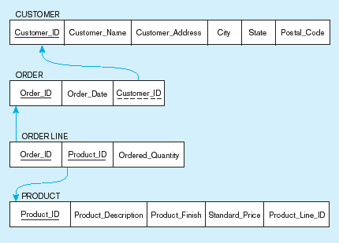
Referential integrity constraints (Pine Valley Furniture)
Referential integrity constraints are drawn via arrows from dependent to parent table

Slide 64
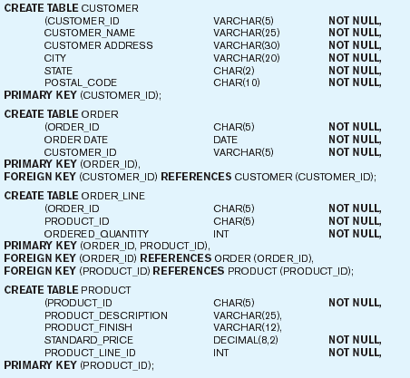
SQL table definitions
Referential integrity constraints are implemented with foreign key to primary key references

Slide 65
Transforming EER Diagrams into Relations
Mapping Regular Entities to Relations
  Simple attributes: E-R attributes map directly onto the relation
  Composite attributes: Use only their simple, component attributes
  Multivalued Attribute–Becomes a separate relation with a foreign key taken from the superior entity

Slide 66


Mapping a regular entity
(a) CUSTOMER entity type with simple attributes
(b) CUSTOMER relation

Slide 67


Mapping a composite attribute
(a) CUSTOMER entity type with composite attribute
(b) CUSTOMER relation with address detail

Slide 68

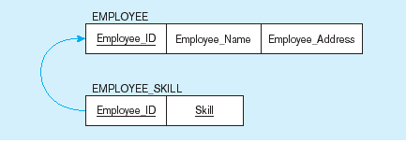
Mapping an entity with a multivalued attribute
(a)
Multivalued attribute becomes a separate relation with foreign key
(b)
One–to–many relationship between original entity and new relation

Slide 69
Transforming EER Diagrams into Relations (cont.)
Mapping Weak Entities
  Becomes a separate relation with a foreign key taken from the superior entity
  Primary key composed of:
    Partial identifier of weak entity
    Primary key of identifying relation (strong entity)

Slide 70
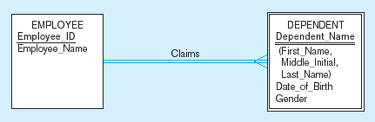
Example of mapping a weak entity
a) Weak entity DEPENDENT

Slide 71
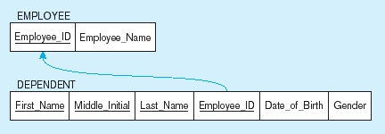
Example of mapping a weak entity (cont.)
b) Relations resulting from weak entity
NOTE: the domain constraint for the foreign key should NOT allow null value if DEPENDENT is a weak entity
Foreign key
Composite primary key

Slide 72
Transforming EER Diagrams into Relations (cont.)
Mapping Binary Relationships
  One-to-Many–Primary key on the one side becomes a foreign key on the many side
  Many-to-Many–Create a new relation with the primary keys of the two entities as its primary key
  One-to-One–Primary key on the mandatory side becomes a foreign key on the optional side

Slide 73
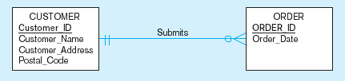
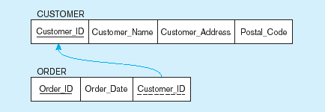
Example of mapping a 1:M relationship
a) Relationship between customers and orders
Note the mandatory one
b) Mapping the relationship
Again, no null value in the foreign key…this is because of the mandatory minimum cardinality
Foreign key

Slide 74
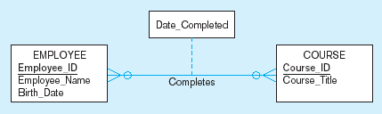
Example of mapping an M:N relationship
a) Completes relationship (M:N)
The Completes relationship will need to become a separate relation

Slide 75
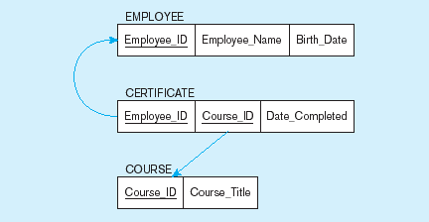
Example of mapping an M:N relationship (cont.)
b) Three resulting relations
Composite primary key
Foreign key
New intersection relation
Foreign key

Slide 76
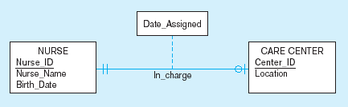
Example of mapping a binary 1:1 relationship
a) In_charge relationship (1:1)
Often in 1:1 relationships, one direction is optional.

Slide 77
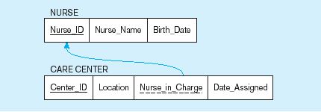
Example of mapping a binary 1:1 relationship (cont.)
b) Resulting relations
Foreign key goes in the relation on the optional side,
Matching the primary key on the mandatory side

Slide 78
Transforming EER Diagrams into Relations (cont.)
Mapping Unary Relationships
  One-to-Many–Recursive foreign key in the same relation
  Many-to-Many–Two relations:
    One for the entity type
    One for an associative relation in which the primary key has two attributes, both taken from the primary key of the entity

Slide 79
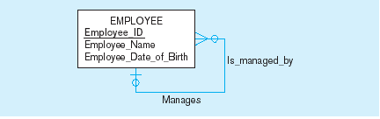

Mapping a unary 1:N relationship
(a) EMPLOYEE entity with unary relationship
(b) EMPLOYEE relation with recursive foreign key

Slide 80
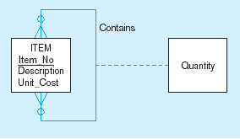
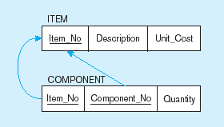
Mapping a unary M:N relationship
(a) Bill-of-materials relationships (M:N)
(b) ITEM and COMPONENT relations

Slide 81
Transforming EER Diagrams into Relations (cont.)
Mapping Ternary (and n-ary) Relationships
  One relation for each entity and one for the associative entity
  Associative entity has foreign keys to each entity in the relationship

Slide 82
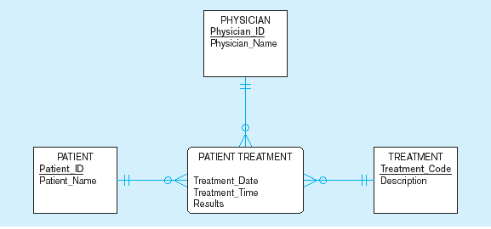
Mapping a ternary relationship
a) PATIENT TREATMENT Ternary relationship with associative entity

Slide 83
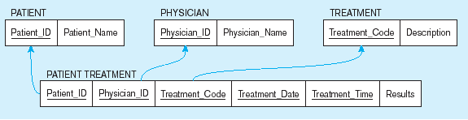
Mapping a ternary relationship (cont.)
b) Mapping the ternary relationship PATIENT TREATMENT
Remember that the primary key MUST be unique
This is why treatment date and time are included in the composite primary key
But this makes a very cumbersome key…
It would be better to create a surrogate key like Treatment#

Slide 84
Data Normalization
Primarily a tool to validate and improve a logical design so that it satisfies certain constraints that avoid unnecessary duplication of data
The process of decomposing relations with anomalies to produce smaller, well-structured relations

Slide 85
Well-Structured Relations
A relation that contains minimal data redundancy and allows users to insert, delete, and update rows without causing data inconsistencies
Goal is to avoid anomalies
  Insertion Anomaly–adding new rows forces user to create duplicate data
  Deletion Anomaly–deleting rows may cause a loss of data that would be needed for other future rows
  Modification Anomaly–changing data in a row forces changes to other rows because of duplication
General rule of thumb: A table should not pertain to more than one entity type

Slide 86
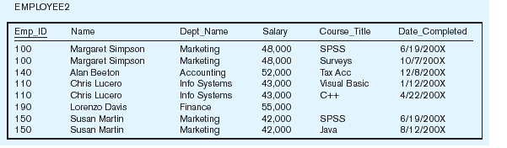
Example
Question–Is this a relation?
Answer–Yes: Unique rows and no multivalued attributes
Question–What should be the primary key?
Answer–Composite: Emp_ID, Course_Title

Slide 87
Anomalies in this Table
Insertion–can’t enter a new employee without having the employee take a class
Deletion–if we remove employee 140, we lose information about the existence of a Tax Acc class
Modification–giving a salary increase to employee 100 forces us to update multiple records
Why do these anomalies exist?
  Because there are two themes (entity types) in this one relation. This results in data duplication and an unnecessary dependency between the entities

Slide 88
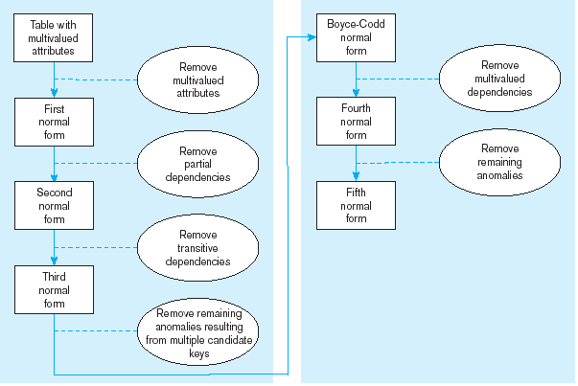
Steps in normalization

Slide 89
First Normal Form
No multivalued attributes
Every attribute value is atomic
Fig. 5-25 is not in 1st Normal Form (multivalued attributes) ➔ it is not a relation
Fig. 5-26 is in 1st Normal form
All relations are in 1st Normal Form

Slide 90
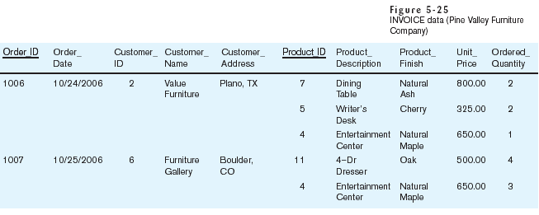
Table with multivalued attributes, not in 1st normal form
Note: this is NOT a relation

Slide 91
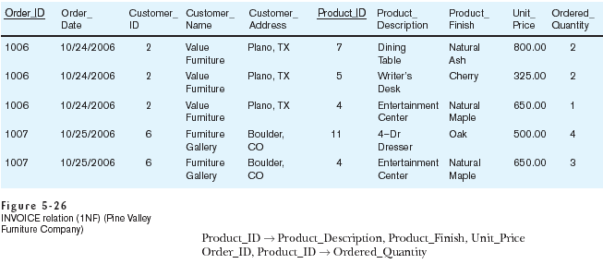
Table with no multivalued attributes and unique rows, in 1st normal form
Note: this is relation, but not a well-structured one

Slide 92
Anomalies in this Table
Insertion–if new product is ordered for order 1007 of existing customer, customer data must be re-entered, causing duplication
Deletion–if we delete the Dining Table from Order 1006, we lose information concerning this item's finish and price
Update–changing the price of product ID 4 requires update in several records
Why do these anomalies exist?
  Because there are multiple themes (entity types) in one relation. This results in duplication and an unnecessary dependency between the entities

Slide 93
Second Normal Form
1NF PLUS every non-key attribute is fully functionally dependent on the ENTIRE primary key
  Every non-key attribute must be defined by the entire key, not by only part of the key
  No partial functional dependencies

Slide 94
Functional Dependencies and Keys
Functional Dependency: The value of one attribute (the determinant) determines the value of another attribute
Each non-key field is functionally dependent on every candidate key
Candidate Key:
  A unique identifier. One of the candidate keys will become the primary key
    E.g. perhaps there is both credit card number and SS# in a table…in this case both are candidate keys

Slide 95
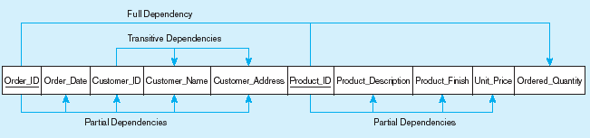
Functional dependency diagram for INVOICE
Order_ID ➔ Order_Date, Customer_ID, Customer_Name, Customer_Address
Customer_ID ➔ Customer_Name, Customer_Address
Product_ID ➔ Product_Description, Product_Finish, Unit_Price
Order_ID, Product_ID ➔ Order_Quantity
Therefore, NOT in 2nd Normal Form

Slide 96
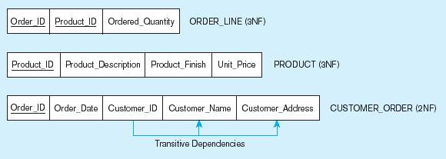
Removing partial dependencies
Getting it into Second Normal Form
Partial dependencies are removed, but there are still transitive dependencies

Slide 97
Third Normal Form
2NF PLUS no transitive dependencies (functional dependencies on non-primary-key attributes)
Note: This is called transitive, because the primary key is a determinant for another attribute, which in turn is a determinant for a third
Solution: Non-key determinant with transitive dependencies go into a new table; non-key determinant becomes primary key in the new table and stays as foreign key in the old table

Slide 98
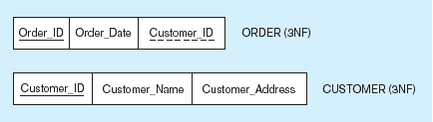
Removing partial dependencies
Getting it into Third Normal Form
Transitive dependencies are removed

Slide 99
Physical Database Design
Purpose–translate the logical description of data into the technical specifications for storing and retrieving data
Goal–create a design for storing data that will provide adequate performance and insure database integrity, security, and recoverability

Slide 100
Physical Design Process
Inputs
Decisions
Normalized relations
Volume estimates
Attribute definitions
Response time expectations
Data security needs
Backup/recovery needs
Integrity expectations
DBMS technology used
Attribute data types
File organizations
Indexes and database architectures
Query optimization
Leads to

Slide 101
Designing Fields
Field: smallest unit of data in database
Field design
  Choosing data type
  Controlling data integrity

Slide 102
Choosing Data Types
CHAR–fixed-length character
VARCHAR2–variable-length character (memo)
LONG–large number
NUMBER–positive/negative number
INEGER–positive/negative whole number
DATE–actual date
BLOB–binary large object (good for graphics, sound clips, etc.)

Slide 103

Example code look-up table
(Pine Valley Furniture Company)
Code saves space, but costs an additional lookup to obtain actual value

Slide 104
Field Data Integrity
Default value–assumed value if no explicit value
Range control–allowable value limitations (constraints or validation rules)
Null value control–allowing or prohibiting empty fields
Referential integrity–foreign-key to primary-key match-ups

Slide 105
Denormalization
Transforming normalized relations into unnormalized physical record specifications
Benefits:
  Can improve performance (speed) by reducing number of table lookups (i.e. reduce number of necessary join queries)
Costs (due to data duplication)
  Wasted storage space
  Data integrity/consistency threats
Common denormalization opportunities
  One-to-one relationship (Fig. 6-3)
  Many-to-many relationship with attributes (Fig. 6-4)
  Reference data (1:N relationship where 1-side has data not used in any other relationship) (Fig. 6-5)

Slide 106

Figure 6-3 A possible denormalization situation: two entities with one-to-one relationship

Slide 107

Figure 6-4 A possible denormalization situation: a many-to-many relationship with nonkey attributes
Extra table access required
Null description possible

Slide 108

Figure 6-5
A possible denormalization situation:
reference data
Extra table access required
Data duplication

Slide 109
Data Replication
Purposely storing the same data in multiple locations of the database
Improves performance by allowing multiple users to access the same data at the same time with minimum contention
Sacrifices data integrity due to data duplication
Best for data that is not updated often

Slide 110
Ensuring Transaction Integrity
Transaction = A discrete unit of work that must be completely processed or not processed at all
  May involve multiple updates
  If any update fails, then all other updates must be cancelled
SQL commands for transactions
  BEGIN TRANSACTION/END TRANSACTION
    Marks boundaries of a transaction
  COMMIT
    Makes all updates permanent
  ROLLBACK
    Cancels updates since the last COMMIT

Slide 111

An SQL Transaction sequence (in pseudocode)

Slide 112
Data Dictionary Facilities
System tables that store metadata
Users usually can view some of these tables
Users are restricted from updating them
Some examples in Oracle 10g
  DBA_TABLES–descriptions of tables
  DBA_CONSTRAINTS–description of constraints
  DBA_USERS–information about the users of the system
Examples in Microsoft SQL Server 2000
  SYSCOLUMNS–table and column definitions
  SYSDEPENDS–object dependencies based on foreign keys
  SYSPERMISSIONS–access permissions granted to users

Slide 113
Routines and Triggers
Routines
  Program modules that execute on demand
  1. Functions–routines that return values and take input parameters
  2. Procedures–routines that do not return values and can take input or output parameters
Triggers
  Routines that execute in response to a database event (INSERT, UPDATE, or DELETE)

Slide 114

Triggers contrasted with stored procedures
Procedures are called explicitly
Triggers are event-driven
Source: adapted from Mullins, 1995.

Slide 115

Routines

Slide 116

Triggers

Slide 117
Stored Procedures are pre-compile objects which are compiled for first time and its compiled format is saved which executes (compiled code) whenever it is called. But Function is compiled and executed every time when it is called.
Basic Difference
1. Function must return a value but in Stored Procedure it is optional( Procedure can return zero or n values).
2. Functions can have only input parameters for it whereas Procedures can have input/output parameters .
3. Functions can be called from Procedure whereas Procedures cannot be called from Function.

Slide 118
Advance Difference
Procedure allows SELECT as well as DML(INSERT/UPDATE/DELETE) statement in it whereas Function allows only SELECT statement in it.
2. Procedures can not be utilized in a SELECT statement whereas Function can be embedded in a SELECT statement.
3. Stored Procedures cannot be used in the SQL statements anywhere in the WHERE/HAVING/SELECT section whereas Function can be.
4. The most important feature of stored procedures over function is to retention and reuse the execution plan while in case of function it will be compiled every time.
5. Exception can be handled by try-catch block in a Procedure whereas try-catch block cannot be used in a Function.
6. We can go for Transaction Management in Procedure whereas we can't go in Function.

Slide 119
Indexes
Indexes are synonymous with performance
on the Oracle database.
Especially on large tables, indexes are the
difference between very slow and efficient
applications.

Slide 120
Rules for Using Indexes
Use on larger tables
Index the primary key of each table
Index search fields (fields frequently in WHERE clause)
Fields in SQL ORDER BY and GROUP BY commands
When there are >100 values but not when there are <30 values

Slide 121
Rules for Using Indexes (cont.)
Avoid use of indexes for fields with long values; perhaps compress values first
DBMS may have limit on number of indexes per table and number of bytes per indexed field(s)
Null values will not be referenced from an index
Use indexes heavily for non-volatile databases; limit the use of indexes for volatile databases
  Why? Because modifications (e.g. inserts, deletes) require updates to occur in index files

Slide 122
Sample CREATE INDEX
  CREATE INDEX emp_last_name_indx
  ON employee (lastname);

Slide 123
Using and Defining Views
Views provide users controlled access to tables
Base Table–table containing the raw data
Dynamic View
  A “virtual table” created dynamically upon request by a user
  No data actually stored; instead data from base table made available to user
  Based on SQL SELECT statement on base tables or other views
Materialized View
  Copy or replication of data
  Data actually stored
  Must be refreshed periodically to match the corresponding base tables

Slide 124
Sample CREATE VIEW
  CREATE VIEW EXPENSIVE_STUFF_V AS
  SELECT PRODUCT_ID, PRODUCT_NAME, UNIT_PRICE
  FROM PRODUCT_T
  WHERE UNIT_PRICE >300
  WITH CHECK_OPTION;
View has a name
View is based on a SELECT statement
CHECK_OPTION works only for updateable views and prevents updates that would create rows not included in the view

Slide 125
Advantages of Views
Simplify query commands
Assist with data security (but don't rely on views for security, there are more important security measures)
Enhance programming productivity
Contain most current base table data
Use little storage space
Provide customized view for user
Establish physical data independence

Slide 126
Disadvantages of Views
Use processing time each time view is referenced
May or may not be directly updateable

